Slide 1
VGC Diabetes
Brompton PCN

Slide 2
Brompton PCN Lead Team
Facilitators | Name | Role
 | Jenny Becker | IAPT
 | Erin Kirby | SPLW
Clinicians | Connie Jughan-minton | GP
 | PCN Pharmacists
 | Aasim Galal
 | Soobia Israr
 | Mary Anan
 | Sarah Greer
 | Hanan
 | Rinku Patel | Pharmacist
 | Louise Farmery | Nurse
Administrator | Elleni Sikin | Admin
Management/finances | Warwick Young | Practice manager
Clinical Director Lead | Anna Cantlay | GP
3 sessions a week
90 mins/session
8-12 patients a session
For 6m (Sept-March)
Notes:
Are practices happy to release pharmacists on a rota basis to support a session a week

Slide 3
7.5% Practice Target
Surgery | T2DM list | 7.5%
Earls Court Surgery | 166 | 12.4
Emperor's Gate Surgery | 142 | 10.65
Kensington Park Medical Centre | 235 | 17.6
Knightsbridge Medical Centre | 327 | 24.5
Royal Hospital Chelsea | 80 | 6
Scarsdale Medical Centre | 178 | 13.5
Stanhope Mews West | 278 | 20.8
The Abingdon Medical Practice | 258 | 19.5
The Chelsea Practice | 154 | 11.5
The Good Practice | 193 | 14.4
The Redcliffe Surgery | 354 | 26.55
TOTAL | 2365 | 177.4
% achievement has been adjusted to:
5% over baseline to reach 50% of payment
7.5% over baseline to reach 100% of payment
Payment is based on number of patients starting a VGC (i.e. attending one session), however there is a quality metric in place to understand how many people with diabetes attend the 2nd and 3rd sessions
Targets set based on numbers at in March 2022, therefore = 190 based on expected population growth
Notes:
Include reserve basis

Slide 4
Case Finding /Prioritisation
Searches run at practice level
BMI >30
Hba1c >58 in <70yr, hba1c >65 in >70yr
BAME
CVD complication
High risk feet
egfr <45
Proteinuria
Exclusion are those engaged with REWIND.
Changed in 2nd recruitment round to ALL T2 diabetics
Notes:
Search on S1

Slide 5
Host Clinic
One PCN host clinic on S1
Practices booked in via remote booking function
PCN Lead team given smart card access/Data sharing agreements

Slide 6
Supporting recruitment
Joint approach with practices and PCN
PCN lead admin for VGC spent time in practices calling patients
Towards the end offered a mix of F2F in the practice and virtual to increase attendance
Booking numbers /practice presented at PCN meetings

Slide 7
Clinician arrives in the session
Facilitator starts the session
Clinician leaves
25-30 minutes clinician answers questions
Facilitator wraps up
Facilitator completes 25-30 minutes goal setting and action planning with patients using motivational interviewing
5-10 minutes welcome and icebreaker
10 minute Fresh Start video,
10-15 minutes facilitator introduces the discussion board (with results e.g. weight, HbA1c, etc) captures questions from patients

Slide 8
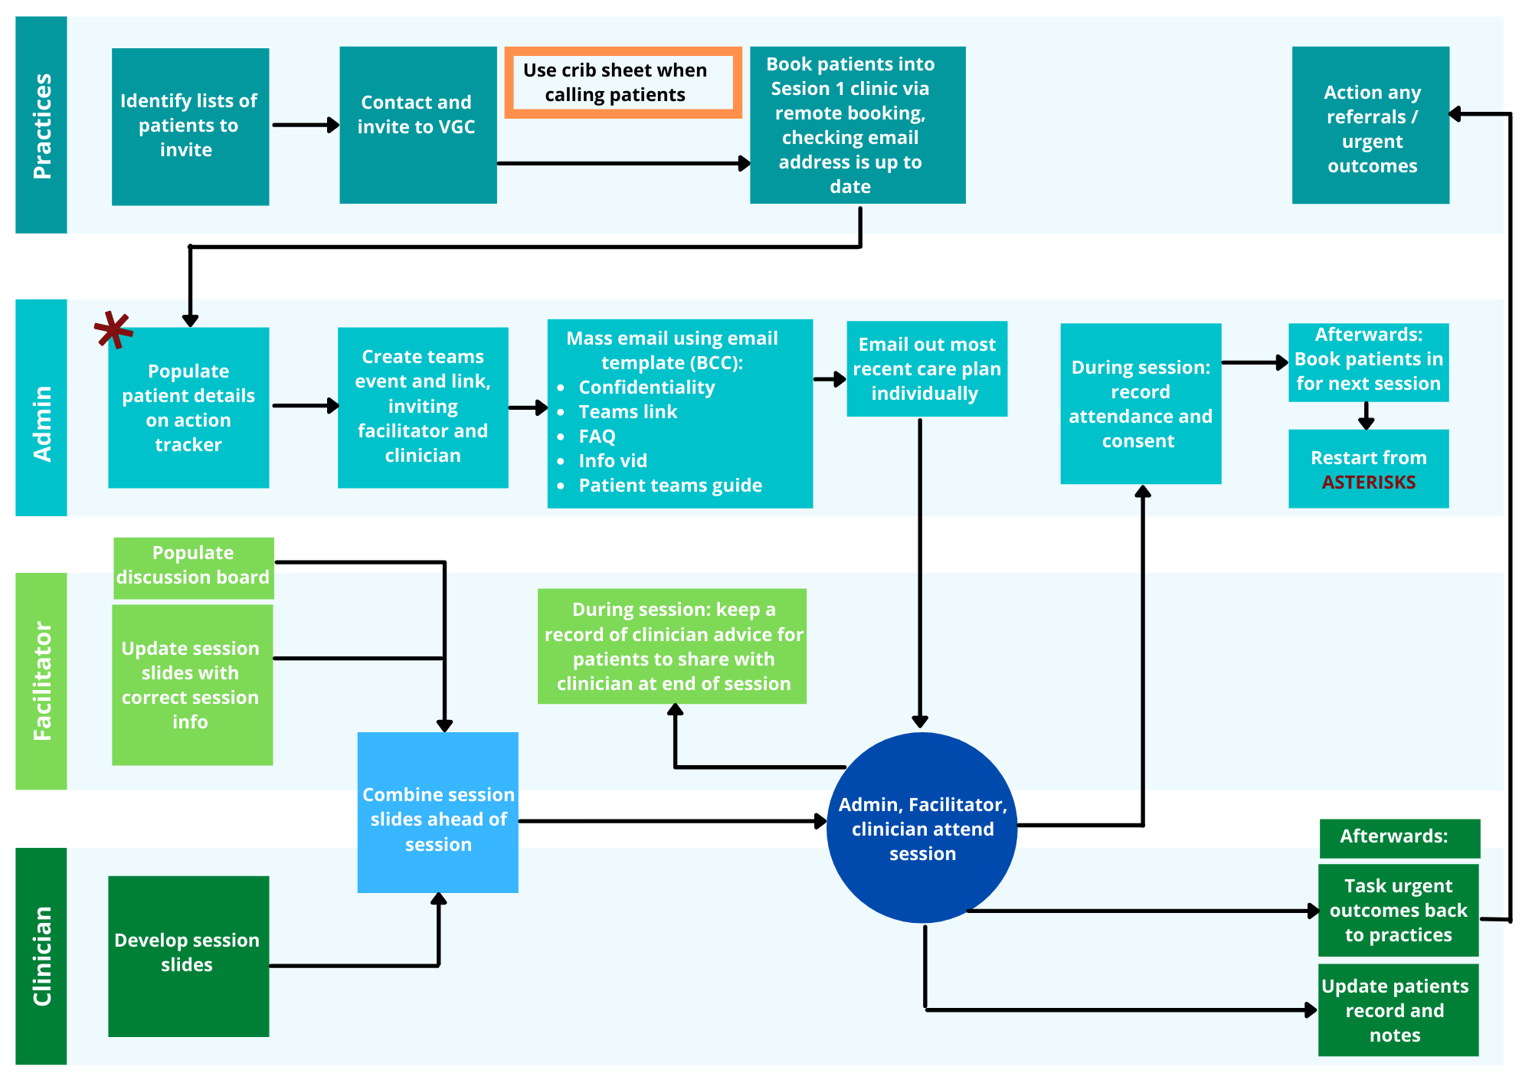

Slide 9
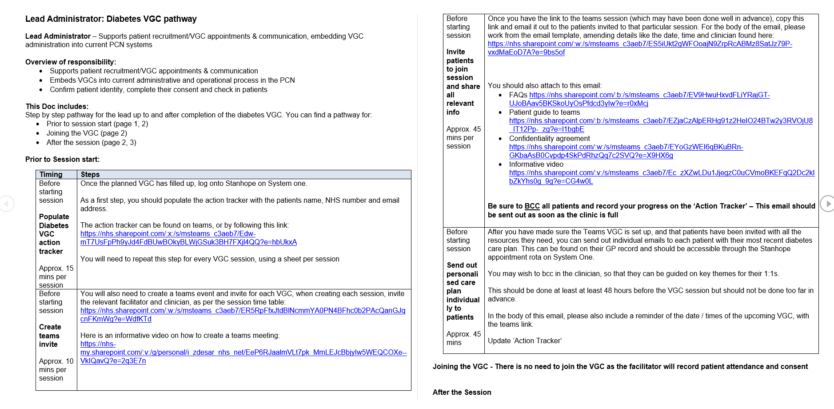
Brompton PCN Teams > General > Diabetes VGC

Slide 10
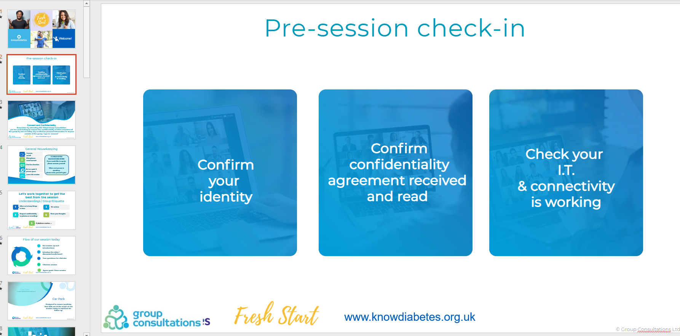
Resources

Slide 11
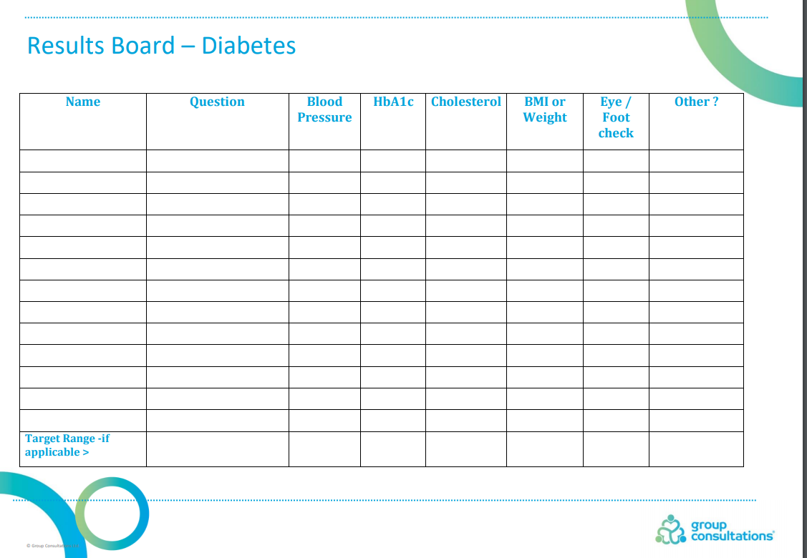

Slide 12
Progress- Appointments (data from November 1
Practice | Booked (future) | Did Not Attend | Finished | Grand Total
A |  | 5 | 3 | 8
B | 1 | 5 | 3 | 9
C | 1 | 4 | 4 | 9
D | 3 | 1 | 5 | 9
E |  |  | 8 | 8
F | 1 | 3 | 5 | 9
G | 9 | 12 | 23 | 44
H |  | 3 | 7 | 10
I | 2 | 13 | 5 | 20
J | 12 | 15 | 7 | 34
Grand Total | 29 | 61 | 70 | 160
Approximately 50% DNA rate with VGC (less with F2F)

Slide 13
Lesson’s Learnt
What worked well?
We held several steering/co-design groups with PCN team ahead of starting
We set up a team whatsapp group to help trouble shoot any issues
Using Clinical Lead’s practice as host practice meant easier oversight over clinic bookings
We were proactive to help improve attendance - texting the day before, calling on the day if did not turn up
F2F worked well for older patients
Good feedback from participants
GP clinical lead driving operations and regular presentation of target achievement at PCN meeting to increase PCN engagement
Diverse PCN lead team which worked well
What were the challenges?
Variable engagement from practices with some practices contributing more
Difficulty with recruiting the numbers we had hoped for
High DNA rates despite efforts to reduce this - unclear what driving factors were
Many patients found they had technical issues on the day
Due to blood bottle shortage/primary care pressures, many had not had up to date care plans and so it was difficult to consult meaningfully 1:1 - sessions felt at times more like group education only
Cost vs benefit - staff cost to be considered against difficult KPI to achieve
Some patients would prefer to be seen by own GP/practice

